Slide 1
Fastest Homomorphic Encryption in the West Hardware Acceleration
Master thesis presentation Jonas Bertels

Slide 2
Selecting the scheme: (B)FV vs. FHEW
Second Generation vs. Third generation

Slide 3
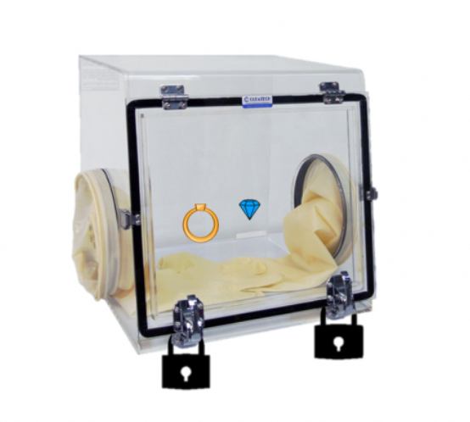
Somewhat homomorphic encryption
Notes:
NOTE: IF EVERYONE KNOWS HOW HOMOMORPHIC ENCRYPTION WORKS, SKIP The first major component of this thesis was selecting what homomorphic encryption scheme to implement. Before I go on, I first have to ask, is everyone here familiar with the basics of homomorphic encryption and bootstrapping?
If not: Homomorphic encryption means encryption on which functions can still be executed. In 2009 Gentry showed that Fully Homomorphic encryption, doing an arbitrary amount of operations on encrypted data is possible. He later explained this using an analogy: imagine a jeweler Alice who wants to let her workers work on precious gems without them being able to steal the gems. She creates a box that allows the workers to manipulate the jewels, like this one. This box would Somewhat Homomorphic Encryption, because while the workers can do some operations, eventually the gloves break down and the workers have to bring the box back to Alice so that she can unlock the box, retrieve the finished jewels.

Slide 4
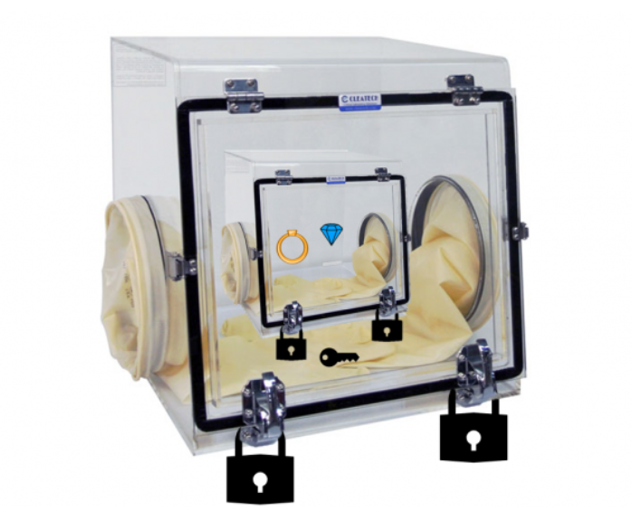
Fully Homomorphic encryption: bootstrapping
Notes:
The idea behind bootstrapping is to turn Somewhat Homomorphic Encryption in to Fully homomorphic encryption by performing the decryption, i.e. the unlocking of the box, while everything is under another encryption. In our analogy, this would be like locking our box, in another box which already has a key for our box inside of it. (Since we using public/private key encryption, we place things into a locked box with the public key). Then our workers can open the inner box and continue working on the jewels. For an arbitrary amount of boxes, we can thus compute an arbitrary amount of functions on data that stays encrypted. The fact that gloves wear out in our analogy is representative of the fact that the homomorphic encryption schemes uses some form of numerical noise to mask the message. As we do addition, and especially multiplication, the amount of noise increases. At some point, decryption (whose last step is usually a sort of rounding operation to remove noise) will no longer return the correct answer.

Slide 5
(R)LWE
For many vectors (a_{i},b_{i}) ϵ (R_{q}, R_{q}), b_{i} = a_{i} * s+ e_{i} with
e_{i} being a randomly sample error term
s being our secret key
a_{i} being a randomly sampled but known vector
… it is not possible to find s (“not computationally feasible” (Roy et al.))
So good public key
Notes:
Just for clarity, I am going to call the person with secret key who encrypted the data originally the user, and the person executing the function on the encrypted data the server.
An example of homomorphic encryption can be seen in the Fan-Vercauteren scheme. This is based on the Ring Learning With Errors Problem, which states the following. For many vectors (ai,bi) ϵ (Rq, Rq), bi = ai * s+ ei with ei being a randomly sample error term and s being our secret key and ai being a randomly sampled but known vector, it is not possible to find s (“not computationally feasible” (Roy et al.))
So in other words, we can use this term as a good public key for s since we can’t reverse engineer the secret from the public key. And this is the case if the server spends all day requesting public keys from the user to be able to guess the secret key.

Slide 6
Scheme (simplified)
Public key: ((-a*s-e)modq, a)
Cipher text: ((-a*s-e)modq)*u+e₁+m, a*u+e₂) with u randomly sampled
Then decryption can be done by multiplying the second part of the cipher text with s and adding it to the first part.
Notes:
Now this is an extremely simplified version of the Fan Vercauteren scheme, just to give an idea: we generate our cipher text from our public key and our message, in such a way that we can get our message back by multiplying the second part of the cipher text with s and adding it to the first part.

Slide 7
Homomorphic addition/multiplication
Ct1 + ct2 = (2*(-a*s-e)modq)*u+e₁₁+e₁₂+m₁+m₂, 2*a*u+e₂₁+e₂₂) = m₁+m₂, with some error to be rounded off
A multiplication also gives:
The correct result + large error term + some factors multiplied by q.
Now the result usually needs to be rescaled
And polymial*polynomial = larger order polynomial, so linearization is necessary
Notes:
Now why do we use this scheme? Because if we add the 2 ciphertexts or multiply the 2 cipherteksts, we still get the correct value after decryption! (if we’ve taken our modulus high enough).
Addition is the most straightforward: when we add, we add the 2 errors of the ciphertexts together and error growth is minimal.
Multiplication is much less straightforward. I did not write down all the terms of the multiplication, but to summarize: afterwards we need to rescale with a certain factor, and relinearize.

Slide 8
Homomorphic multiplication
As we’ve multiplied (cp1[0], cp1[1]) and (cp2[0], cp2[1]) together (remembering that cp1[0] + cp1[1]*s = message), can see m1 *m2 = cp1[0]*cp2[0] + cp1[0] *cp2[1]*s + cp1[1]*cp2[0]*s + cp1[1]*cp2[1] *s²
So now a method to remove s² is also required
And bootstrapping with this algorithm is not practical…
Notes:
We need to rescale because the actual algorithm is scaling with a certain factor, and if you multiply 2 values scaled with a factor delta, the result will be scaled by a factor delta² and thus we need to divide back by delta to get our original scaling.
Secondly, we need to be able to remove the secret key squared term from our result. We call this the linearization step, but I will not go into details here.

Slide 9
FV in SEAL
Microsoft SEAL is a homomorphic encryption library that contains FV
Tried implementing Arcsin(X/1500) *1/2 with arcsin(x) = x+x^3/6+3x^5/40
Bootstrapping is not a thing, so not trivial to implement
Notes:
To understand how FV actually worked and get an idea for the size of the parameters I was going to be working with, I installed micrsoft SEAL, a library for homomorphic encryption. I tried implementing a simple function (for calculating the angle you have to fire something at to reach a certain distance, which means calculating an arcsin, which can be approximated using a taylor expansion). Because there is no bootstrapping, it is necessary to determine in advance what size of polynomial coefficients will be for every multiplication done to calculate the polynomial series. Additionally, as the TA’s told me and I also found out by trying, it is hard to floating point operations with integers, when rescaling has to be done after every multiplication, requiring another multiplication with a constant factor.

Slide 10
CKKS steps
Choose coefficient
Choose scale
Generate public, private and relin keys
Notes:
Therefore I switched to CKKS, which can be seen as a similar scheme designed for floating point operations.
To give an idea of what needs to be done: Firstly, the coefficient modulus of the polynomials must be chosen, so that there is enough noise budget to allow for the function that you want to execute. Then the scale (i.e. the precision of the floating point numbers) must also be chosen. Then public, private and realinerisation keys must be generated. Finally we can start doing multiplications and addition, but after every multiplication we must rescale and relinearize, and we need to do modulus switching as we go through the list of coefficient modulus primes that we generated to do our calculation.

Slide 11
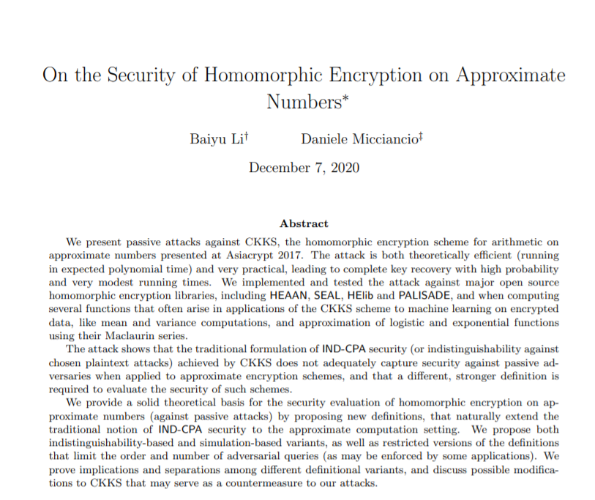
CKKS?

Slide 12
Summary
Good for SIMD
Not good for depth of multiplications
Somewhat inflexible
Notes:
This required about a 100 lines of code for a rather simpel formula. It executed fairly quickly, and both FV and CKKS are good at allowing Single Instruction, Multiple Data, but as can be seen from this example, they only allow for a limited amount of computations, and algorithms that are already out there and require a lot of instructions will thus not easily translate in to programs that can homomorphically execute data.
They are however good at doing homomorphic encryptions for a given, low-depth application. This can also be seen in a hardware acceleration for the Fan-Vercauteren scheme done by COSIC in 2018. This implementation could do FV very quickly, at 400 homomorphic multiplications per second, but is limited to a multiplicative depth of 4. This is enough for a lot of applications, but can limit its flexibillity in a general role.

Slide 13
FHEW (Fastest Homomorphic Encryption in the West)
One NAND gate
Bootstrap immediately
137ms for 128 bit security for 1 NAND + bootstrap
No limit on function execution
Notes:
FHEW, called that way as a reference to the Fastest Fourier Transform in the West library, is part of the so-called third generation schemes. It attempts to tackle the long length of the bootstrapping process by only executing one NAND gate (other simple gate functions are also possible) and then immediately bootstrapping.This makes it a true fully homomorphic scheme, as the bootstrapping can actually be done within a reasonable amount of time, namely 137miliseconds for NAND + bootstrap for 128 bit security on a intel i7. In other words, while only one NAND gate can be done at a time (later papers show parellisation is possible), there is no limit on the depth of our circuit, and as all functions can be written as a combination of logic gates, no limit on the functions that can be executed.

Slide 14
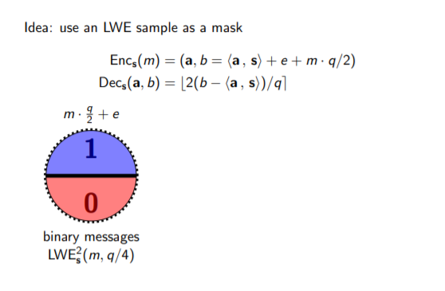
Based on RLWE (from Ducas/Micciancio)
Notes:
FHEW is also based on RLWE. The slides I’m about to show are taken from a excellent, very visual presentation by the creators of FHEW, Léo Ducas and Daniele Micciancio. Our message is a single bit. If it is 0, we could represent it as some error, if it is 1, we could represent it as 256 with some error added to it. (512 is a usual value for q). In this case our maximum error is equal to +/- 128.

Slide 15
Based on RLWE (from Ducas/Micciancio)
q = 512 so you can look at this as: if m = 0, we are in the lower half with e, if m=1, then we are in the upper half with 256 + e

Slide 16
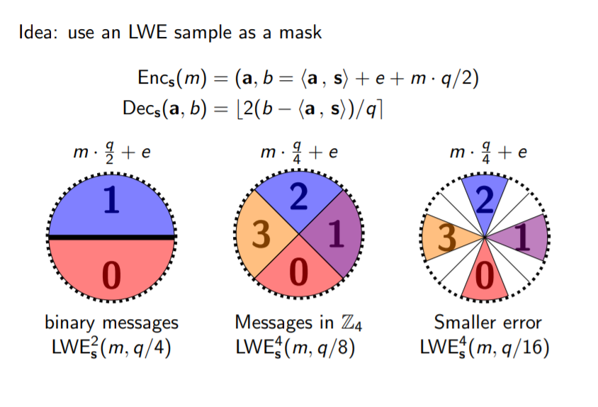
Notes:
Now the representation that we use is one where there are 4 possible messages, with the message being multiplied by 128, or ¼ of the modulus q. We also have a smaller error of value 64 or q/8, so that there are values that are never reached by a given message and error. (these white spaces).

Slide 17
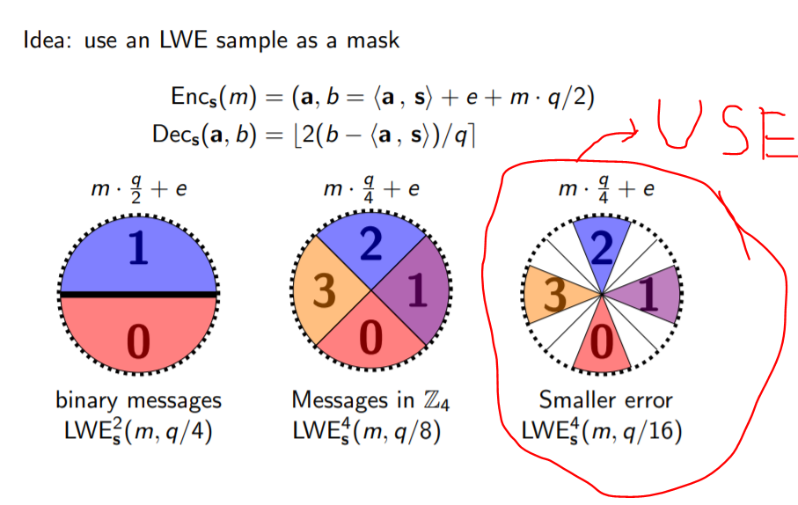

Slide 18
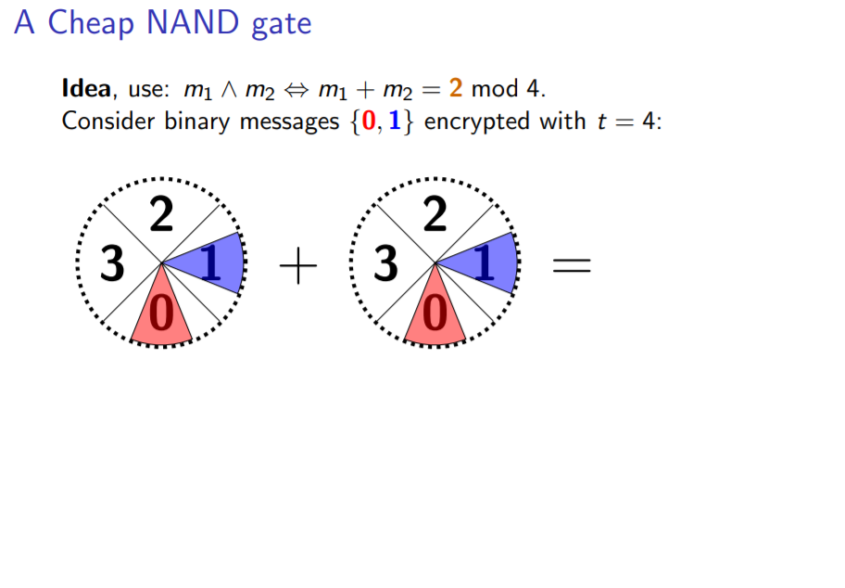
Notes:
We can use this for addition. As you can see, the result now has more error than the beginning. Now if we consider every on the top left to be 1 and everything on the bottom right to be 0, we have a AND gate. To make this a NAND, we rotate by 5q/8, in other words we consider the bottom right to be 1 and the other 0 and this results in the results that we expect from a NAND gate for given input values.

Slide 19
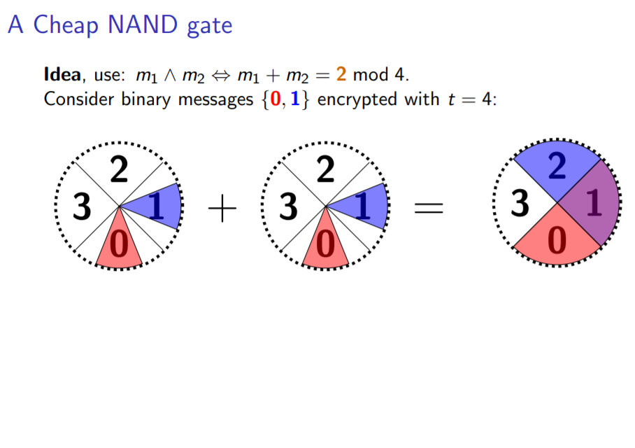
Notes:
We can use this for addition. As you can see, the result now has more error than the beginning. Now if we consider every on the top left to be 1 and everything on the bottom right to be 0, we have a AND gate. To make this a NAND, we rotate by 5q/8, in other words we consider the bottom right to be 1 and the other 0 and this results in the results that we expect from a NAND gate for given input values.

Slide 20
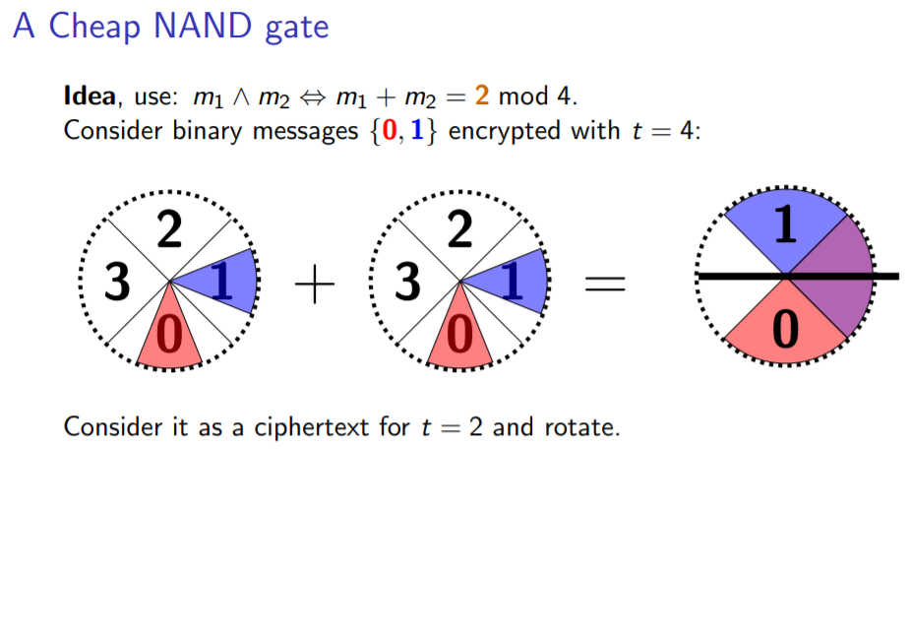
Notes:
We can use this for addition. As you can see, the result now has more error than the beginning. Now if we consider every on the top left to be 1 and everything on the bottom right to be 0, we have a AND gate. To make this a NAND, we rotate by 5q/8, in other words we consider the bottom right to be 1 and the other 0 and this results in the results that we expect from a NAND gate for given input values.

Slide 21
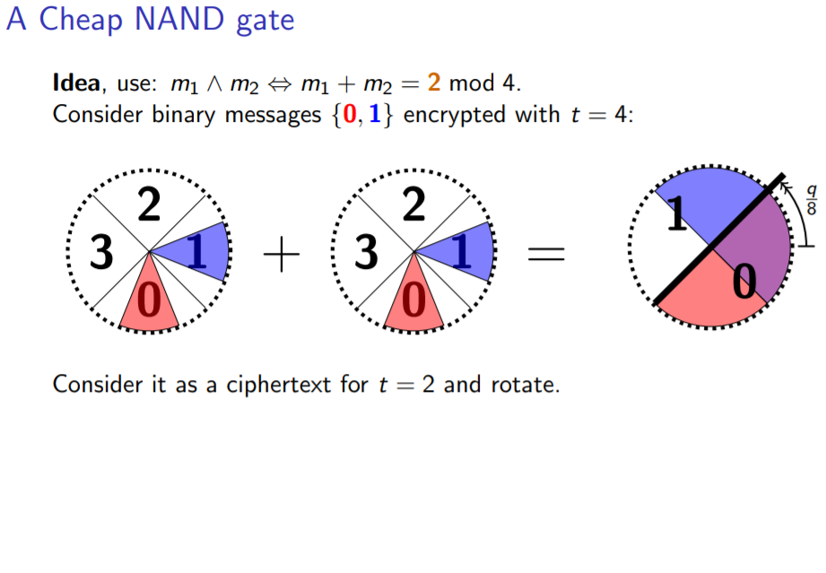
Notes:
We can use this for addition. As you can see, the result now has more error than the beginning. Now if we consider every on the top left to be 1 and everything on the bottom right to be 0, we have a AND gate. To make this a NAND, we rotate by 5q/8, in other words we consider the bottom right to be 1 and the other 0 and this results in the results that we expect from a NAND gate for given input values.

Slide 22
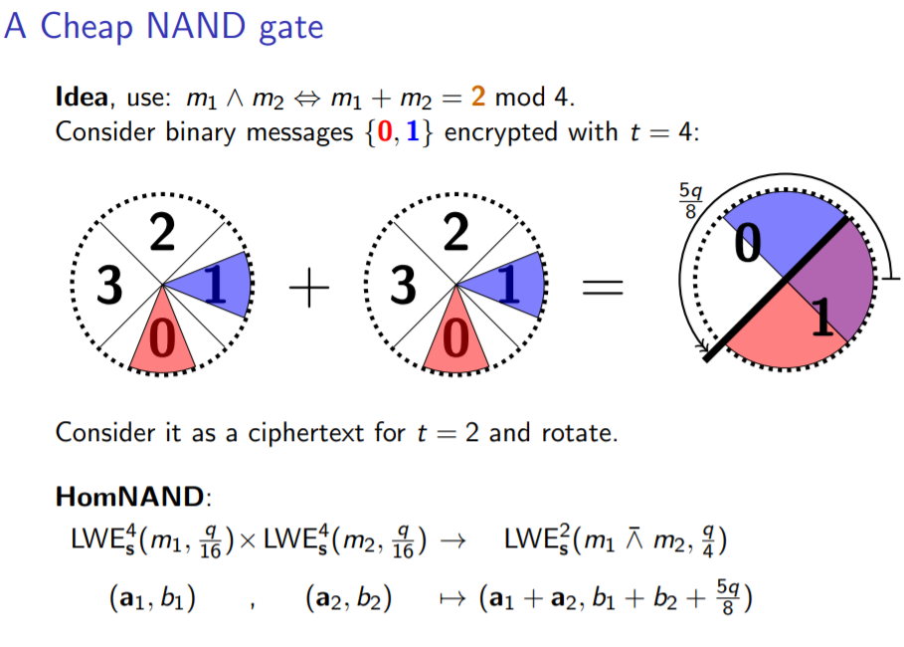
Notes:
We can use this for addition. As you can see, the result now has more error than the beginning. Now if we consider every on the top left to be 1 and everything on the bottom right to be 0, we have a AND gate. To make this a NAND, we rotate by 5q/8, in other words we consider the bottom right to be 1 and the other 0 and this results in the results that we expect from a NAND gate for given input values.

Slide 23
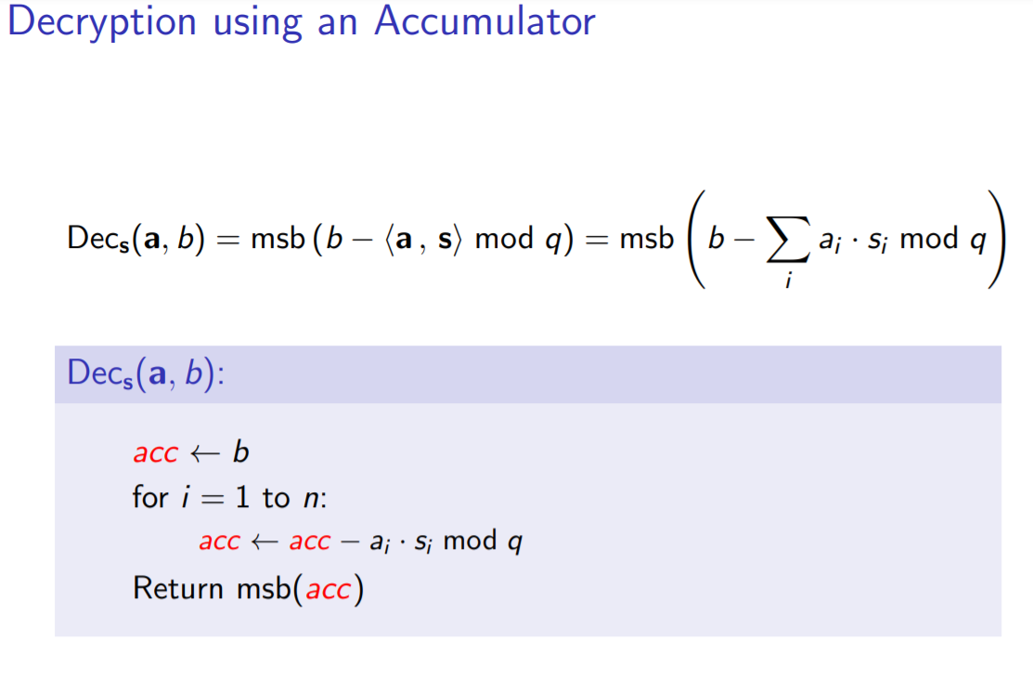
Notes:
Then we need to bootstrap: remember, bootstrappping is doing decryption operations homomorphically, i.e. doing the decryption operations with an encrypted secret key. This reduces the noise back down to the original level, completing our algorithm.

Slide 24
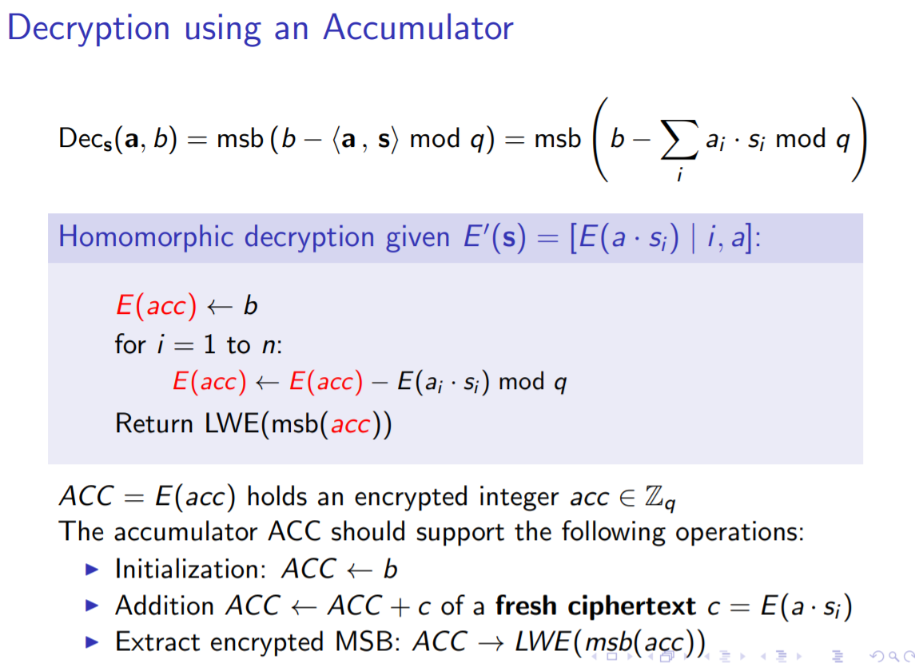
Notes:
Then we need to bootstrap: remember, bootstrappping is doing decryption operations homomorphically, i.e. doing the decryption operations with an encrypted secret key. This reduces the noise back down to the original level, completing our algorithm.

Slide 25
Intermezzo: why am I choosing this?
Flexible because fully homomorphic
Speed up is necessary
No hardware implementation yet (for FHEW or TFHE)
GPU implementations have been made

Slide 26

LWE
LWE ciphertexts: (a, b) with
With q = 512 and n = 512, so a is a 512x1 vector with elements modulo 512 and b is an integer modulo 512
Notes:
LWE ciphertexts look as follows and standard parameters are given. If we simply wanted to decrypt, we would calculate b-<a,s> and retreive our message through rounding, but this requires a secret key and gives us our result, which the server isn’t supposed to have.

Slide 27
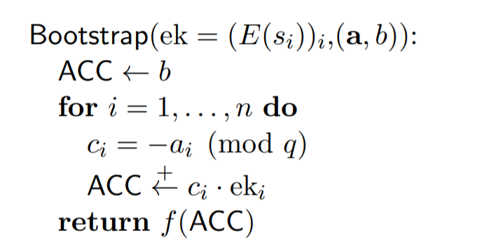
LWE decryption
Now we want to decrypt our message (to remove noise)… BUT (decryption is b-a*s)
We still want our message to be a secret so we need to do the decryption under another encryption, which does not have to be the same scheme
Notes:
Instead, we want to encrypt this scheme under another scheme so we can decrypt the LWE ciphertext and gain the benefits, namely noise removal from our ciphertext due to rounding, without making security pointless. Remember

Slide 28
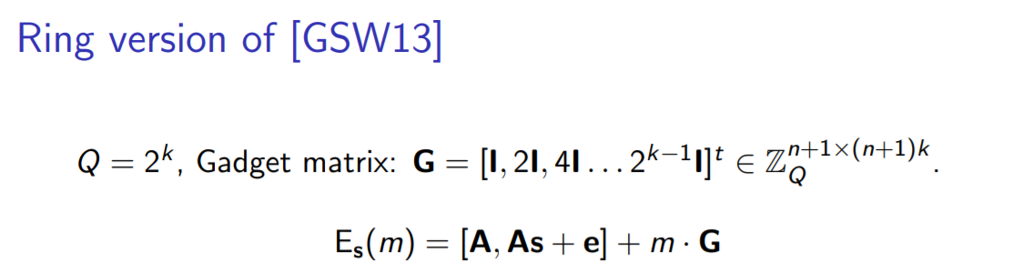
Change LWE input to RLWE
RLWE is more efficient so we take our LWE input → RLWE
Our Secret Keys are encrypted in yet another scheme: RGSW
Notes:
Now LWE is less efficient than RLWE so we take the input and turn it into RLWE. We also encrypt our secret keys using RGSW, which is a scheme that encrypts a message as 27 RLWE encryptions of 0, with message multiplied with shifted unity matrix 27 times. Q is a 27 bit prime. In our scheme, rather than multiplication with 2, we are multiplying with B_{r} =23, but this is simply an optimization and you can forget that.

Slide 29

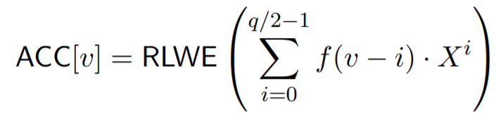
Initialization
Notes:
If our input is a LWE value called v, then it becomes an encrypted X^{v} RLWE value. To compute a rounding function f (which also does our rotation for our NAND), we store all the function output for given the function inputs 0 to 255, and we choose our rounding function so that the output for a value more that 255 is equal to the negative output of value minus 255. Then we can initialize our accumulator to a polynomial with the function outputs as coefficients.

Slide 30
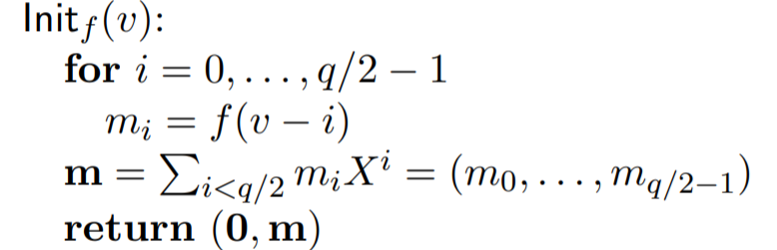
Initialization (q=512), m=0 or 1
Notes:
What we return, namely (0, m) is a noiseless RLWE with an a that’s equal to 0. But it is an RLWE encryption so we can do operations with this and add noise.

Slide 31
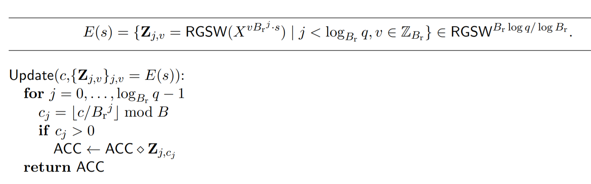
Accumulation
Notes:
Now we come to accumulation. Seen from the LWE standpoint, we’re now going to subtract the inner product of a*s from our b. a is public and in plaintext, but we are allowed to multiply a RGSW value by a plaintext a. We then “subtract” this a_{i}*s_{i} to our Accumulator by multiplying the RGSW and RLWE encryptions together. This is done via a special multiplicatio which returns an RLWE encryption of the Accumulator which, from a RLWE standpoint, rotates the functions by a_{i}*s_{i} , and which, from a LWE standpoint, looks like an subtraction with a_{i} * s_{i}. We then extract our result by taking the first value of our rotated functions, which is going to be our decrypted LWE whose error has been rounded of by our functions (and which has been rotated as required in advance). We would then have to do a key switching operation to complete our algorithm but… (continued)

Slide 32
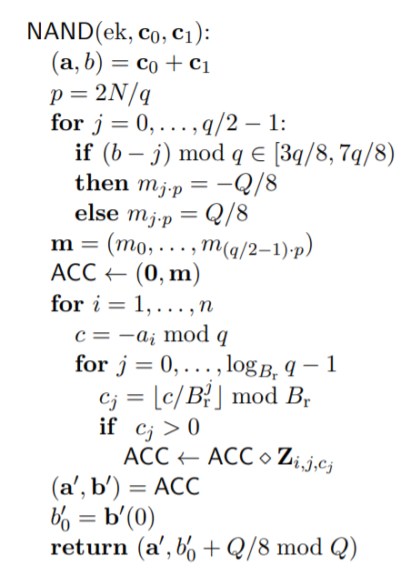
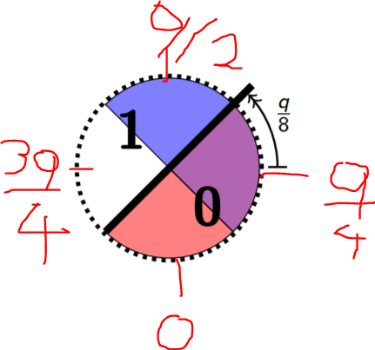
NAND->
Noiseless RLWE ->
q = 512
Q ~ 2^27
B_{r} = 23
LWE decrypted, but encrypted as RLWE->
Return LWE of RLWE (not under same key)>
Notes:
The most performance challenging part for the server is of course the accumulation step. Every RLWE times RGSW operation is a vector times matrix operation.

Slide 33
NTT multiplication

Slide 34
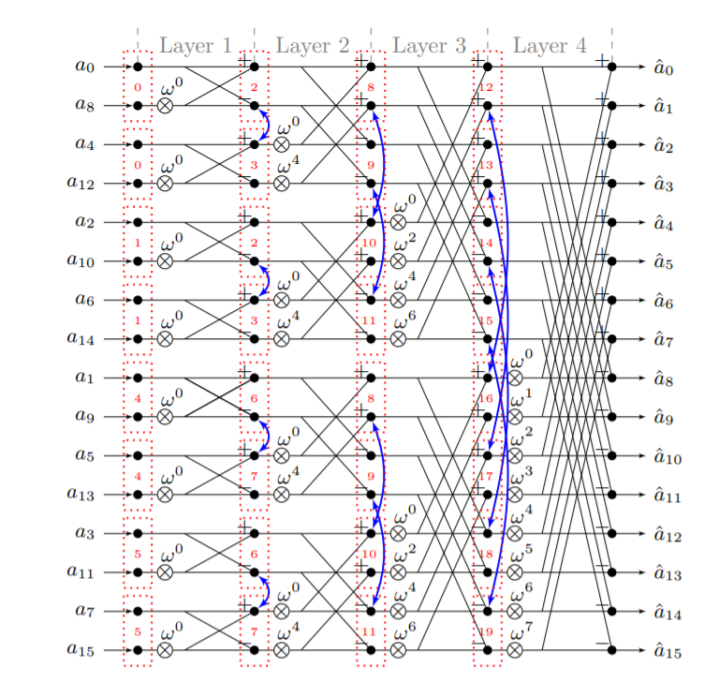

Slide 35
Parameterized Hardware Accelerators for Lattice-Based Cryptography and Their Application to the HW/SW Co-Design of qTESLA (2020)
Artix-7
CS-NTT and GS-NTT⁻¹ but unify in one HW block
n/2 · log2 (n) per NTT
(n, q)= (1024, 343576577)
11, 455 cycles @ 126 MHz for 1 polynomial multiplication

Slide 36
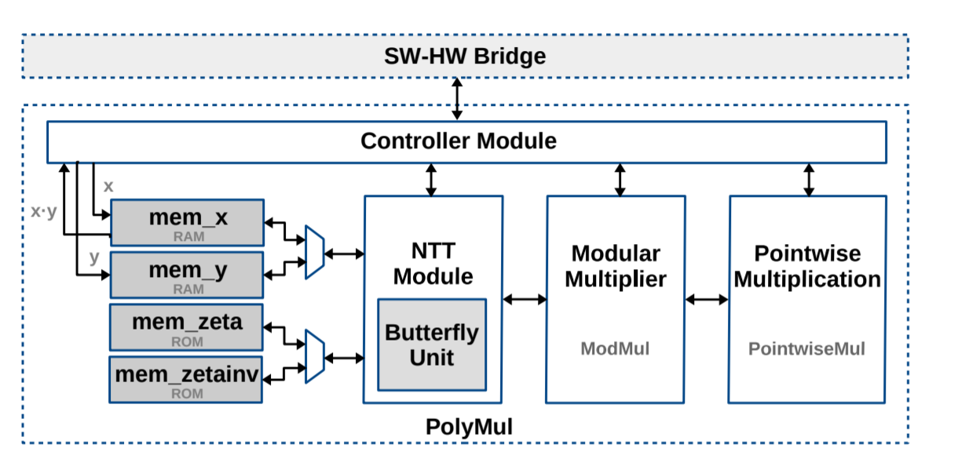
Parameterized Hardware Accelerators for Lattice-Based Cryptography and Their Application to the HW/SW Co-Design of qTESLA

